Slide 1


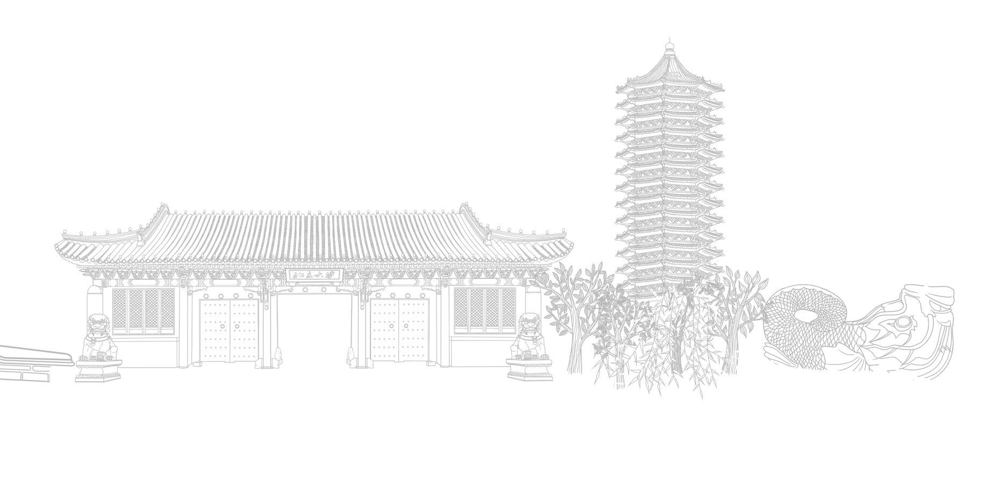
Different executive function impairments in medication-naïve children with attention-deficit/hyperactivity disorder comorbid with oppositional defiant disorder and conduct disorder
Presenters
Ningning Liu
Peking University Sixth Hospital/Institute of Mental Health, Beijing, China;
Supervisor:Qiujin Qian;
Co-supervisor:Lu Liu;
2022.11.13
Notes:
Than you very much ,...Thank you for your kind introduction.
Good morning, I am glad to have the opportunity to make a presentation here.
Today's topic is...

Slide 2

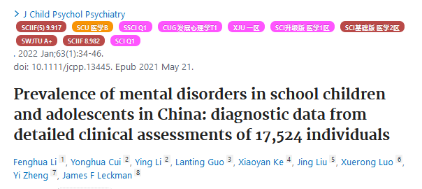

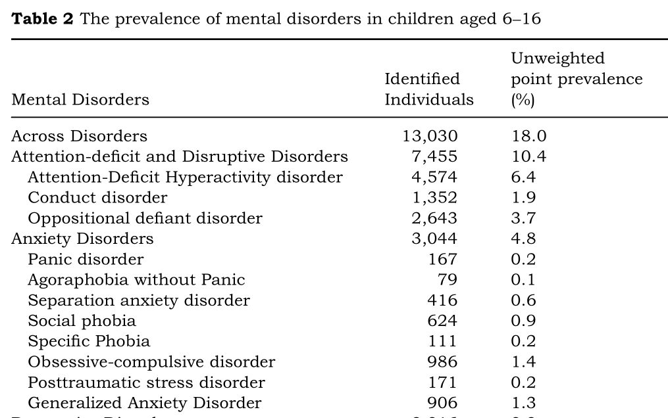

Backgroud
Attention deficit hyperactivity disorder（ADHD）
Prevalence:6.4%；
Comorbidities
Disruptive behavior disorders （DBD，~50%）
Li.,et.al. J Child Psychol Psychiatry, 2022; Posner., et.al. Lancet. 2020
Notes:
ADHD就是一个典型的代表（common neurodevelopmental disease）
他的特点就是不恰当的和受损的（ inappropriate and impairing）Inappropriate and impairing inattention, motor hyperactivity, and impulsivity;
，通常会持续到成人（with difficulties often continuing into adulthood）
我国近期流行病学研究显示，6-16岁在校学生ADHD的患病率是6.4%，是该研究中儿童青少年最常见的精神障碍(Li et al., 2022)。
儿童ADHD经常共患各种疾病（often co-occur with many comorbidities ），比如（like ）oppositional defiant disorder (ODD) and conduct disorder (CD)，这两个合称为which are collectively referred to as disruptive behavior disorders (DBD)。
共病在ADHD是很常见的，

Slide 3
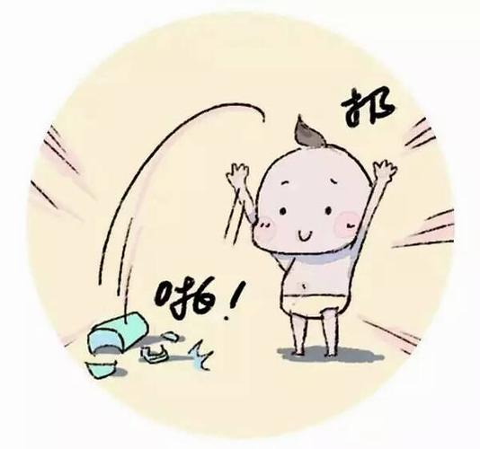
Backgroud
ADHD_{DBD+}
ADHD_{ODD+}
ADHD_{CD+}
Oppositional defiant disorder (ODD)
Conduct disorder (CD)
Eskander., et.al. Cureus, 2020; Lahey., et.al. Springer US, 2000; Caye., et al. EUR CHILD ADOLES PSY, 2016.
Notes:
oppositional defiant disorder (ODD) and conduct disorder (CD)，这两个合称为are collectively referred to as disruptive behavior disorders (DBD)。

Slide 4
Backgroud
ADHD_{DBD+}
ADHD_{DBD+}
ADHD_{only}
ADHD_{ODD+}
ADHD_{CD+}
Oppositional defiant disorder (ODD)
Conduct disorder (CD)
Eskander., et.al. Cureus, 2020; Lahey., et.al. Springer US, 2000; Caye., et al. EUR CHILD ADOLES PSY, 2016.
Notes:
Most studies found no significant difference between ADHD with DBD (ADHDDBD+) and ADHD without DBD (ADHDonly) in EFs impairments,
which should be interpreted with caution considering that many studies suggesting ADHD with CD (ADHDCD+) and ADHD with ODD (ADHDODD+) should be treated differently. However, few studies have attempted to separate these two disorders when studying the EFs and brain imaging of ADHDDBD+

Slide 5
Backgroud
ADHD_{DBD+}
ADHD_{DBD+}
ADHD_{only}
**
ADHD_{ODD+}
ADHD_{CD+}
Oppositional defiant disorder (ODD)
Conduct disorder (CD)
ADHD_{CD+}
ADHD_{ODD+}
ADHD_{only}
Eskander., et.al. Cureus, 2020; Lahey., et.al. Springer US, 2000; Caye., et al. EUR CHILD ADOLES PSY, 2016.
Notes:
oppositional defiant disorder (ODD) and conduct disorder (CD)，这两个合称为which are collectively referred to as disruptive behavior disorders (DBD)。
Most studies found no significant difference between ADHD with DBD (ADHDDBD+) and ADHD without DBD (ADHDonly) in EFs impairments,
which should be interpreted with caution considering that many studies suggesting ADHD with CD (ADHDCD+) and ADHD with ODD (ADHDODD+) should be treated differently. However, few studies have attempted to separate these two disorders when studying the EFs and brain imaging of ADHDDBD+

Slide 6
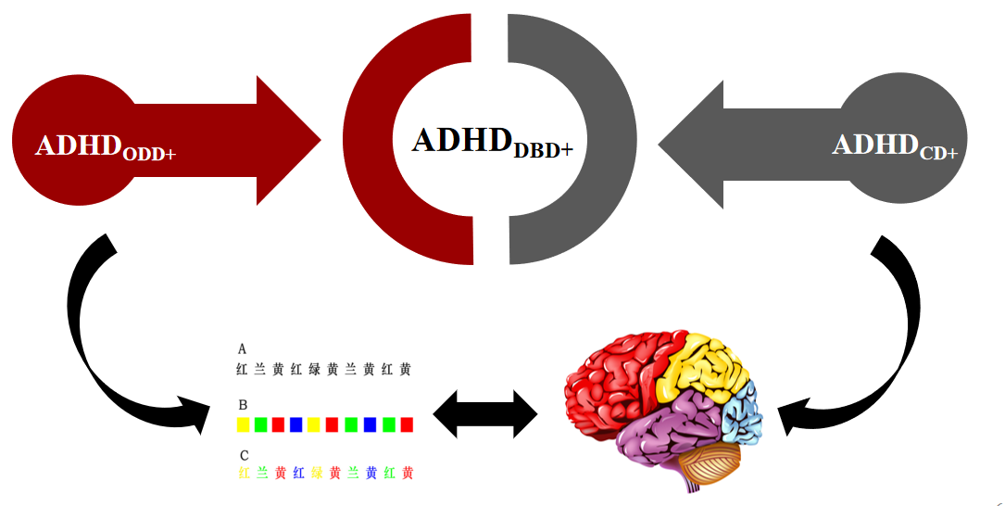
Backgroud
ADHD_{CD+} and ADHD_{ODD+} exhibited different EFs impairment?
CD/ODD symptoms were associated with EFs performanc
Potential underlying neural basis of it?
Ningning., et.al. Under Review
Notes:
.Thus, based on our ongoing research in ADHD, we have now recruited a large sample size of medication-naïve children with ADHD and HC
We aim to investigate that
(1) whether ADHDCD+ and ADHDODD+ exhibited different EFs impairment; (2) whether CD/ODD symptoms were associated with EFs performance and what was the potential underlying neural basis of it.
We hope this study could help us to understand the heterogeneity of ADHD to some extend and help us tailor the treatment plans according to their underlying cognitive and brain processes.

Slide 7
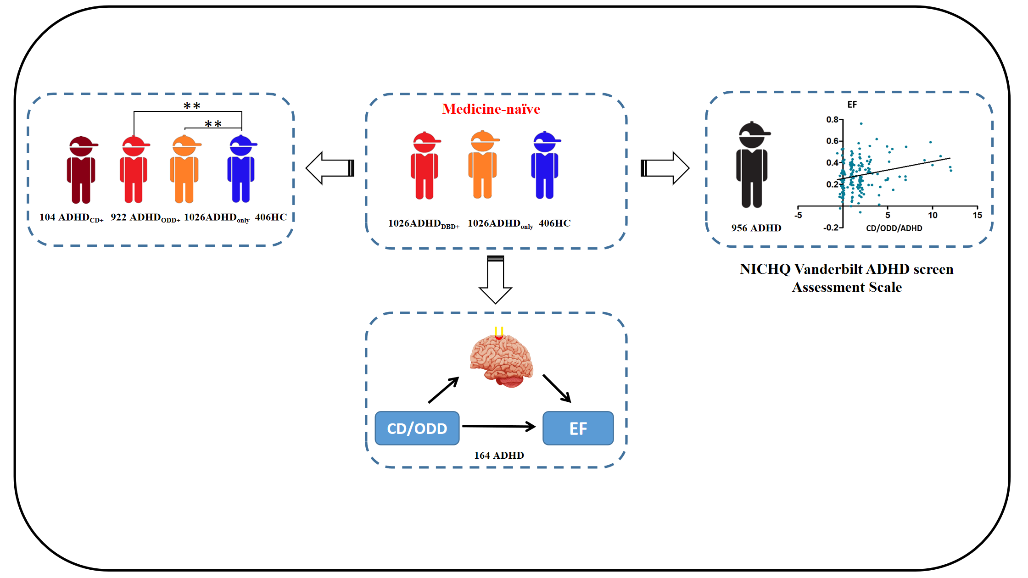
Flowchart of the whole study design
CD/ODD
Notes:
A total of 1,026 ADHDDBD+ (104 ADHDCD+, 922 ADHDODD+), 1,026 ADHDonly and 406 healthy controls (HCs) were included in the present study. The EFs performance in ADHDDBD+, ADHDonly and HCs was firstly compared. Then, we classified ADHDDBD+ into ADHDCD+ and ADHDODD+ to compare the EFs in ADHDCD+, ADHDODD+, ADHDonly and HCs. Next, the correlation between EFs and CD/ODD scores was calculated to validate the results from a quantitative view. Finally, with functional near-infrared spectroscopy (fNIRS), we measured the brain activation of 164 children with ADHD and carried out a serious mediation effect model to investigate the neural basis of this association.

Slide 8
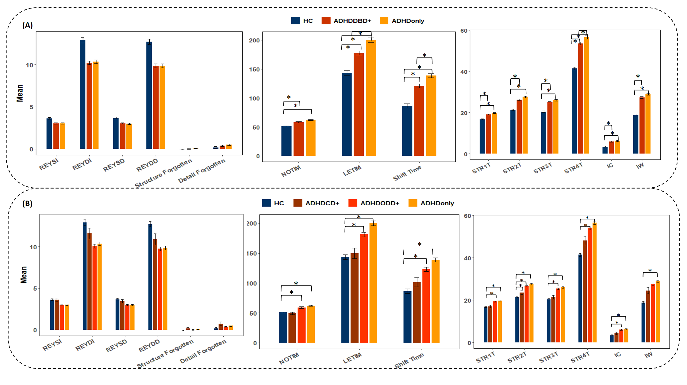
Results
ADHD_{DBD+,} ADHD_{only}exhibited impairment in EFs compared with HCs
EFs impairment in ADHD_{ODD+} and ADHD_{only} compared with HC
Fig 1. Group comparisons of neurocognitive tasks.
Notes:
Both ADHDDBD+ and ADHDonly exhibited impairment in EFs compared with HCs, while no significant difference was found between ADHDDBD+ and ADHDonly. When dividing the ADHDDBD+ into ADHDCD+ and ADHDODD+, we only found EFs impairment in ADHDODD+ and ADHDonly compared with HCs
However, different from ADHDODD+, ADHDCD+ did not exhibit significant impairment in EFs compared with HCs

Slide 9
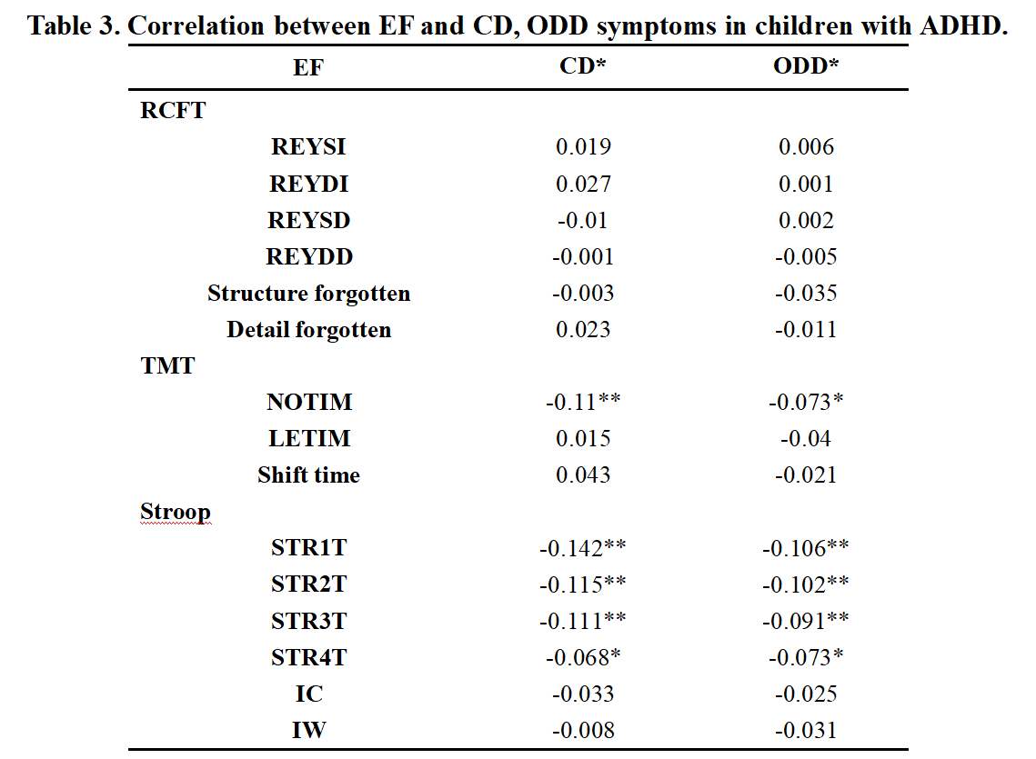
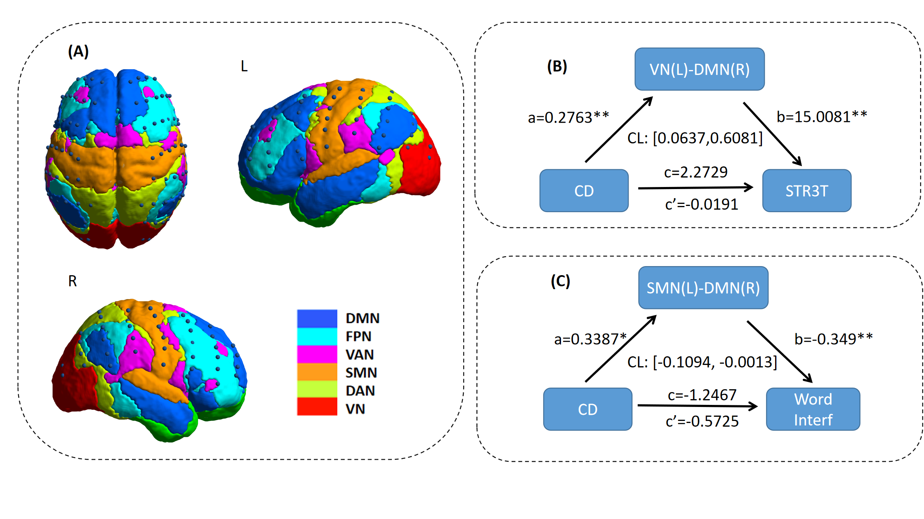
Results
More severe ODD/CD symptoms were associated with better EFs
Relationship between CD symptoms and inhibition function was mediated by the FC of SMN(L) - DMN(R)
Fig 2. The mediation results of fNIRS.
Notes:
Correlation analysis showed that more severe ODD/CD symptoms were associated with better EFs in children with ADHD. The mediation analysis revealed that age has a significant effect on the results, and the relationship between CD symptoms and inhibition function was mediated by the FC of SMN(L) - DMN(R) in the younger group.

Slide 10
Conclusion
ADHD_{DBD+}
ADHD_{ODD+}
ADHD_{CD+}
ADHD is a highly heterogeneous disease.
No significant difference was even found between ADHD_{CD+} and HCs.
Comorbid ODD/CD is an important contributing factor to the heterogeneity of ADHD.

Slide 11
Conclusion
ADHD_{ODD+}
ADHD_{DBD+}
ADHD_{CD+}
ADHD is a highly heterogeneous disease.
No significant difference was even found between ADHD_{CD+} and HCs.
Comorbid ODD/CD is an important contributing factor to the heterogeneity of ADHD.
Notes:
ADHD is a highly heterogeneous disease. Our findings indicated that within ADHD individuals, comorbid ODD and CD might be with less impairments in EFs, and no significant difference was even found between ADHDCD+ and HCs. The results remind us that comorbid ODD/CD is an important contributing factor to the heterogeneity of ADHD. This study provided a unique perspective for the understanding the heterogeneity and the search for a better treatment of different ADHD subgroups.

Slide 12

Acknowledgements
1. Peking University Sixth Hospital/Institute of Mental Health, Beijing 100191, China 2. NHC Key Laboratory of Mental Health (Peking University), National Clinical Research Center for Mental Disorders (Peking University Sixth Hospital), Beijing 100191, China
3. Beijing Normal University, State Key Laboratory of Cognitive Neuroscience and Learning, Beijing 100875, China
*Corresponding Author:
Qiujin Qian, qianqiujin@bjmu.edu.cn;
Haijing Niu, niuhjing@bnu.edu.cn;
Lu Liu, liulupku@bjmu.edu.cn
Notes:
acknowledge the contributions of all collaborators and their institutions.

Slide 13


Thank you
liuningning@pku.edu.cn
Notes:
That’s all for my talk. Thank you for your attention.
If there are any question, I’d be delighted to disscuss with you.
I hope that was clear. If you do have any questions, please don't hesitate to ask them.

Slide 14
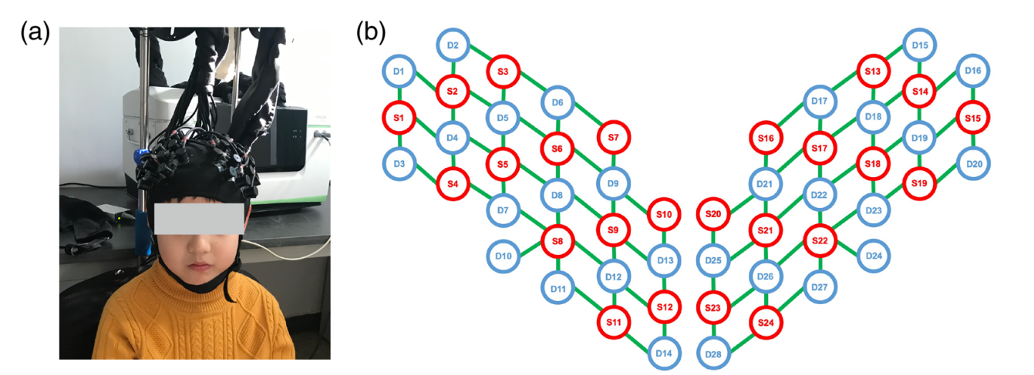
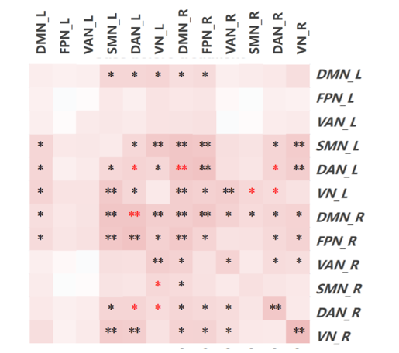
Method
2,458人： 1,026 ADHD_{DBD+}, 1,026 ADHD_{only} and 406 HCs
Age rang：6~17y
IQ ≥ 80
Medicine-naïve
No history of head trauma, neurological illness or other severe diseases
(c)
(d)
CD/ODD：NICHQ Vanderbilt ADHD screen Assessment Scale
Working Memory: Rey–Osterrieth complex figure test (RCFT)
Cognitive flexibility: The Trail Making Test (TMT)
Inhibitory control：Stroop Color-Word Test
Wang., et.al. Neurophoton. 2020
Notes:
Rey–Osterrieth complex figure test, The Trail Making Test, and Stroop Color-Word Test

Slide 15
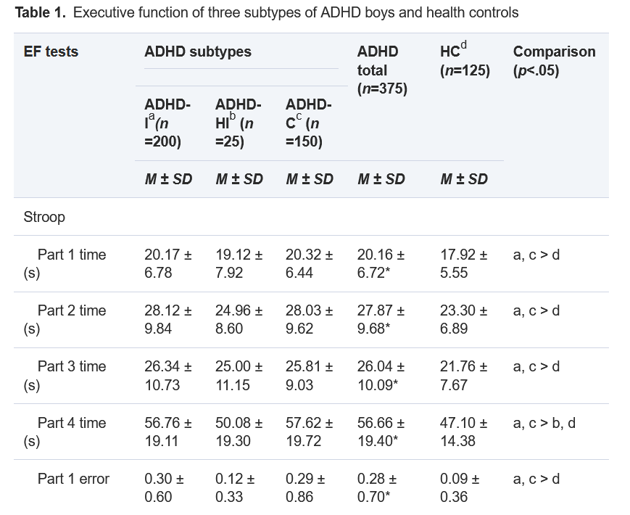
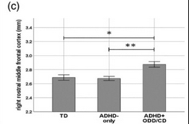
提问：以往EF,脑研究如何
共病DBD的儿童ADHD的EF和脑影像研究
ADHD_{DBD+}存在EF和脑影像异常
ADHD_{DBD+}存在反应抑制，工作记忆等损害；
ADHD_{DBD+}分数各向异性（FA）↓；白质灰质体积↓
01
02
ADHD_{ODD+}和ADHD_{CD+}被当作一个整体
ADHD_{CD+}很少
Noordermeer SDS, et al. Biol Psychiatry. 2017

Slide 16

100
Persistence Risk Fackor
Number of ADHD symptoms
Intelligence quetient
Gender
Evidence of maltreatment
Socail class
Prescence of ODD/CD
Rasied by single parent family
Evidence of mother’s depress
Persistence (%)
Full diagnostic criteria
15%
0
Age
Babyhood Chilhood Adolescence Adulthood
ADHD over Lifetime

Slide 17
100
Persistence Risk Fackor
Prescence of ODD/CD
Number of ADHD symptoms
Intelligence quetient
Gender
Evidence of maltreatment
Socail class
Rasied by single parent family
Evidence of mother’s depress
Persistence (%)
Full diagnostic criteria
15%
0
Age
Babyhood Chilhood Adolescence Adulthood
ADHD over Lifetime

Slide 18

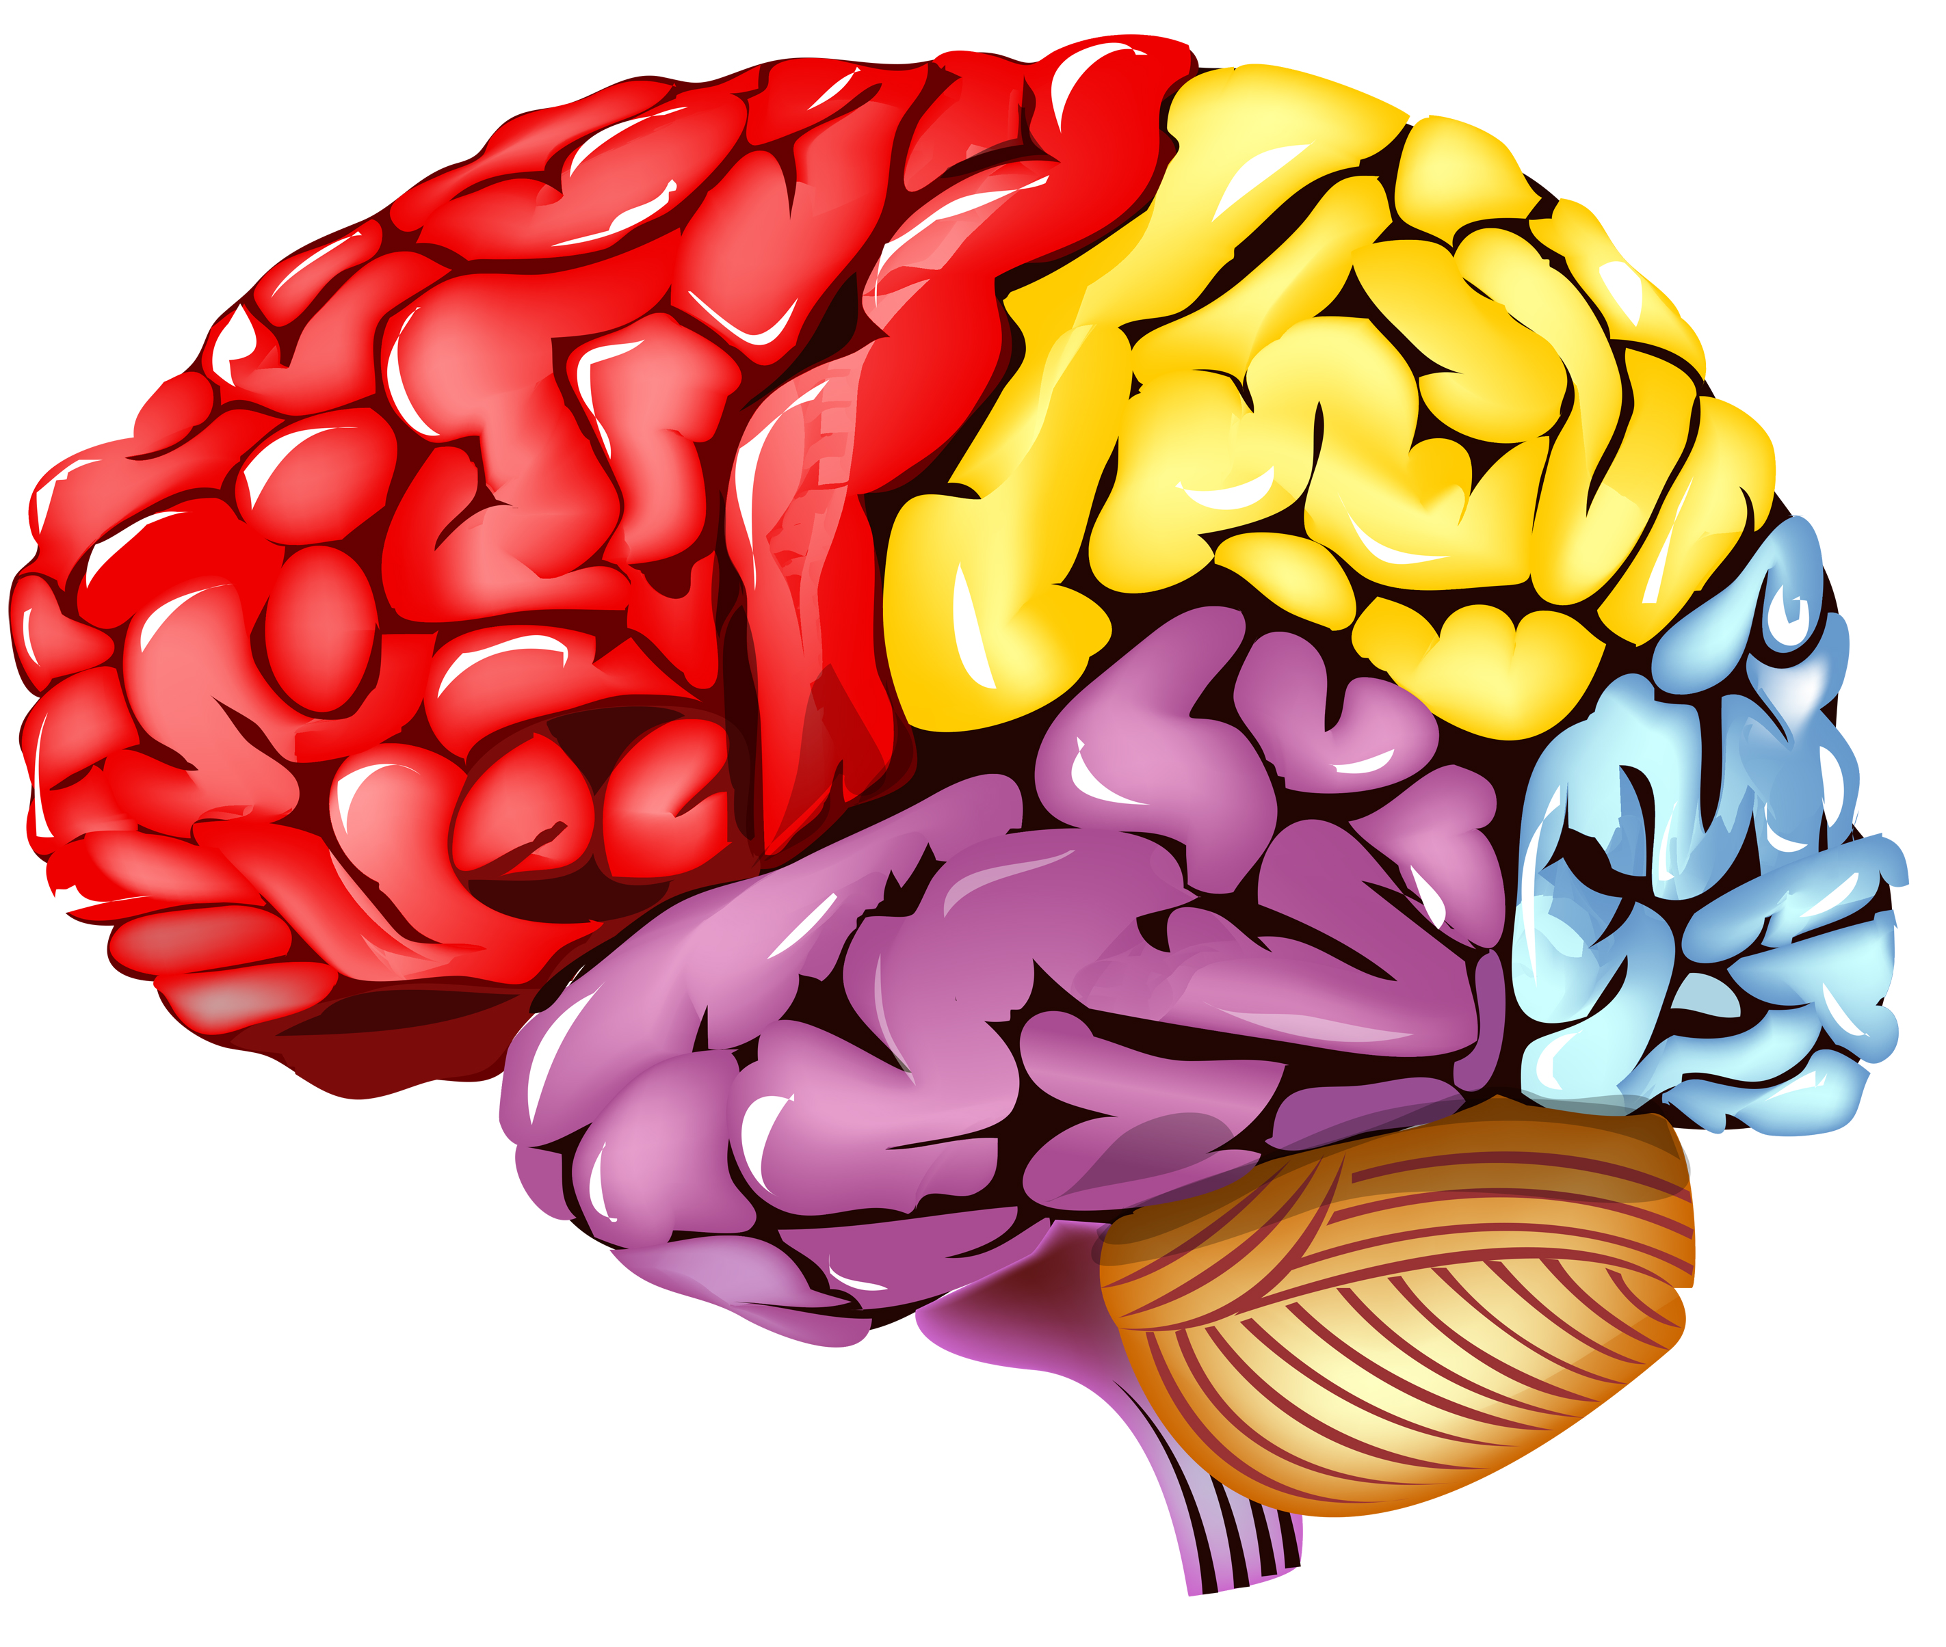
100
Prescence of CD
Persistence (%)
15%
0
Age
Babyhood Chilhood and Adolescence Adulthood
ADHD over Lifetime

Slide 19
100
共病DBD
Per持续率 (%)
15%
0
年龄
婴儿时期 儿童青少年时期 成人时期
ADHD 终身发展

